Slide 1

Data Structures and Algorithms Instructor: Maira Sami
maira.sami@szabist.edu.pk
Campus 100
Room No. 101

Slide 2
Stacks
Lecture 4

Slide 3
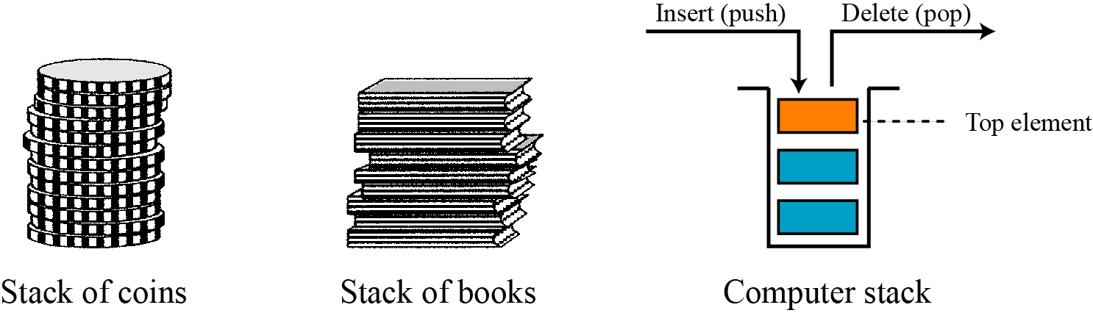
A stack is an ordered collection of homogenous data elements where the insertion and deletion operations take place at one end only.
A stack is a LIFO (Last-In/First-Out) data structure.
A stack is sometimes also called a pushdown store.
The insertion and deletion operations are specifically termed PUSH and POP.
The position of the stack where these operations are performed is known as TOP of the stack.
An element in a stack is termed an ITEM.
The maximum number of elements that a stack can accommodate is termed SIZE

Slide 4
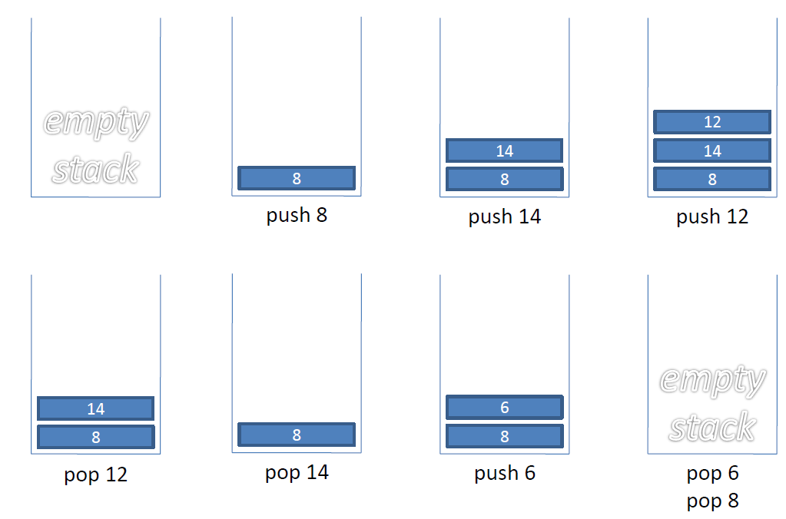
Stacks Example

Slide 5
Stack Operations
Main stack operations:
push(object): inserts an element.
object pop(): removes and returns the last inserted element.
Auxiliary stack operations:
object top(): returns the last inserted element without removing it.
integer size(): returns the number of elements stored.
boolean isEmpty(): indicates whether no elements are stored.

Slide 6
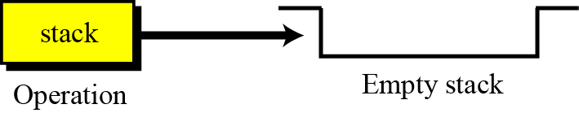
The stack operation
The stack operation creates an empty stack. The following shows the format.

Slide 7
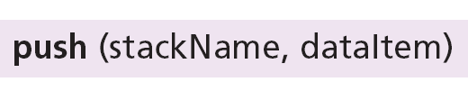
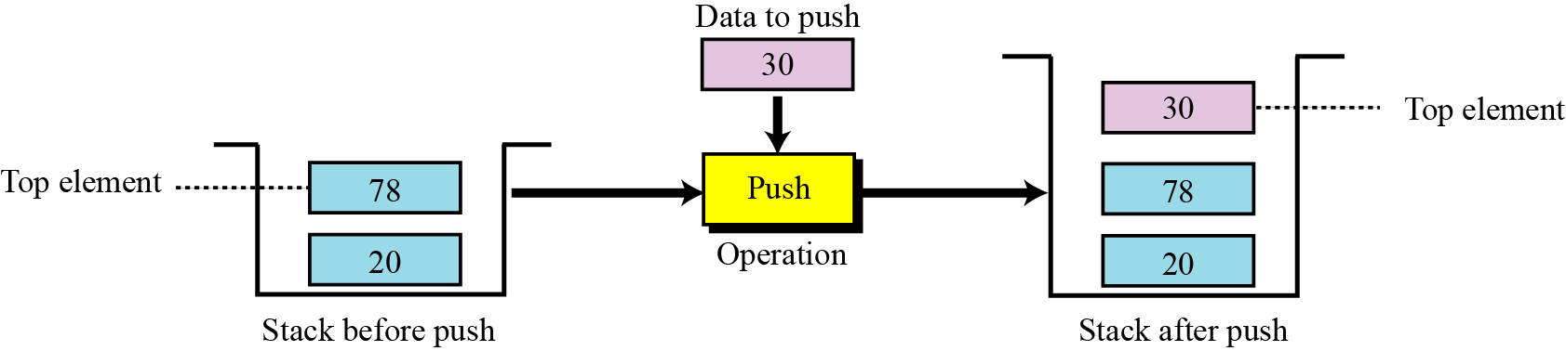
The push operation
The push operation inserts an item at the top of the stack. The following shows the format.
7

Slide 8
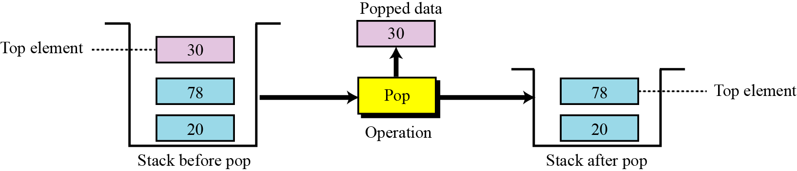
The pop operation
The pop operation deletes the item at the top of the stack. The following shows the format.
8
8

Slide 9
The empty operation
The empty operation checks the status of the stack.
This operation returns true if the stack is empty and false if the stack is not empty.

Slide 10
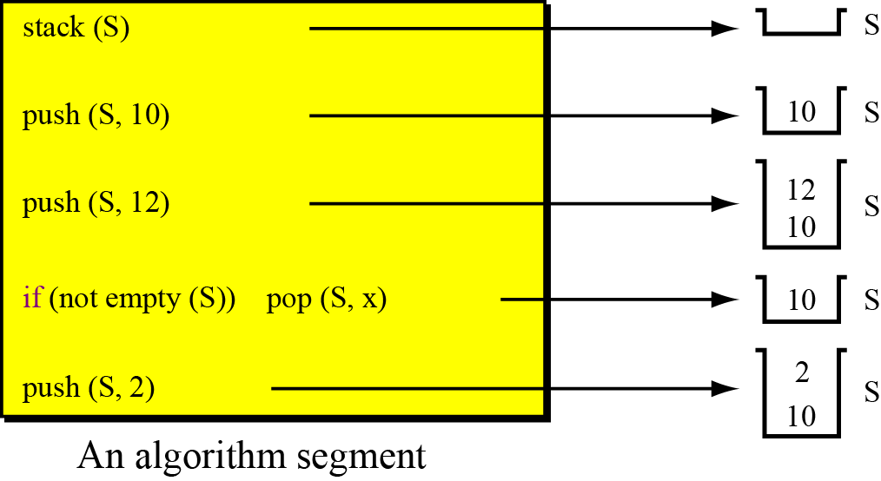
Example
A segment of an algorithm that applies the previously defined operations on a stack S.

Slide 11
Selecting storage structures
Two choices
Select position 0 as top of the stack
Select position 0 as bottom of the stack

Slide 12
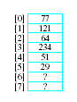
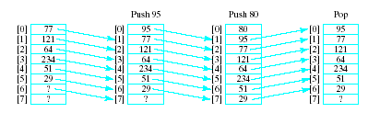
Select position 0 as top of the stack
Model with an array
Let position 0 be top of stack
Problem … consider pushing and popping
Requires much shifting

Slide 13
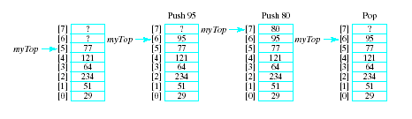
Select position 0 as bottom of the stack
A better approach is to let position 0 be the bottom of the stack
Thus our design will include
An array to hold the stack elements
An integer to indicate the top of the stack

Slide 14
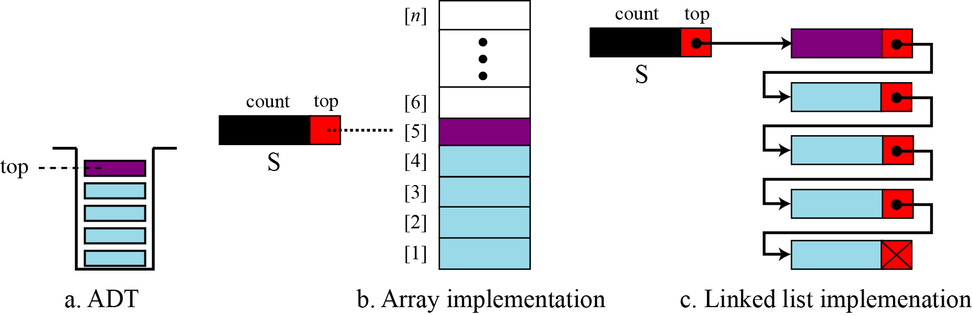
Implementing a Stack
There are two ways we can implement a stack:
Static implementation (Using an array)
Dynamic implementation (Using a linked list)
Notes:
Static implementation using arrays is a very simple technique but is not a flexible way, as the size of the stack has to be declared during the program design, because after that, the size cannot be varied (i.e., increased or decreased). Moreover static implementation is not an efficient method when resource optimization is concerned (i.e., memory utilization). For example a stack is implemented with array size 50. That is before the stack operation begins, memory is allocated for the array of size 50. Now if there are only few elements (say 30) to be stored in the
stack, then rest of the statically allocated memory (in this case 20) will be wasted, on the other hand if there are more number of elements to be stored in the stack (say 60) then we cannot change the size array to increase its capacity.

Slide 15
Implementing a Stack
Implementing a stack using an array is fairly easy.
The bottom of the stack is at data[0]
The top of the stack is at data[numItems-1]
push onto the stack at data[numItems]
pop off of the stack at data[numItems-1]

Slide 16
Implementing a Stack
Implementing a stack using a linked list isn’t that bad either…
Store the items in the stack in a linked list
The top of the stack is the head node, the bottom of the stack is the end of the list
push by adding to the front of the list
pop by removing from the front of the list

Slide 17
Stack (Array Implementation)
Algorithm for push:
Suppose STACK[SIZE] is a one dimensional array for implementing the stack, which will hold the data items. TOP is the pointer that points to the top most element of the stack. Let DATA is the data item to be pushed.
1. If TOP = SIZE – 1, then:
(a) Display “The stack is in overflow condition”
(b) Exit
2. TOP = TOP + 1
3. STACK [TOP] = ITEM
4. Exit

Slide 18
Stack (Array Implementation)
Algorithm for pop:
Suppose STACK[SIZE] is a one dimensional array for implementing the stack, which will hold the data items. TOP is the pointer that points to the top most element of the stack. DATA is the popped (or deleted) data item from the top of the stack.
1. If TOP < 0, then
(a) Display “The Stack is empty”
(b) Exit
2. Else remove the Top most element
3. DATA = STACK[TOP]
4. TOP = TOP – 1
5. Exit

Slide 19
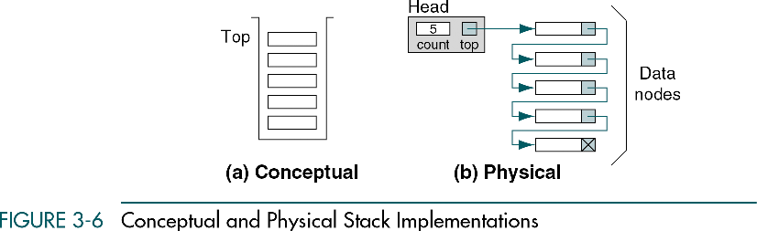
Stack (Linked List Implementation)

Slide 20
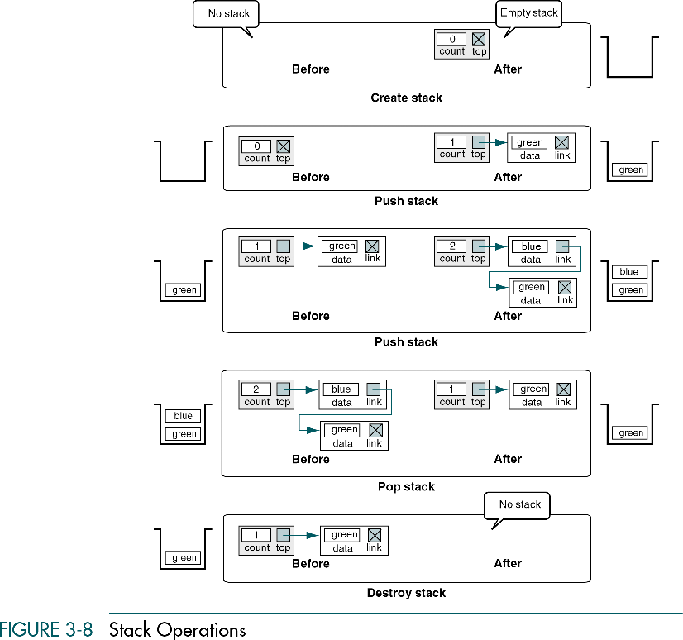
Example

Slide 21
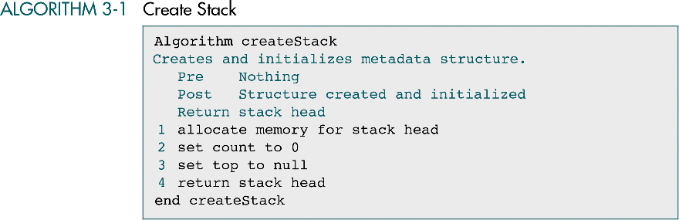

Slide 22
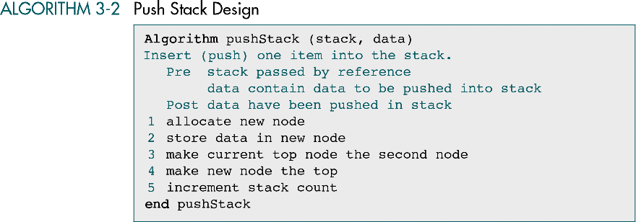

Slide 23
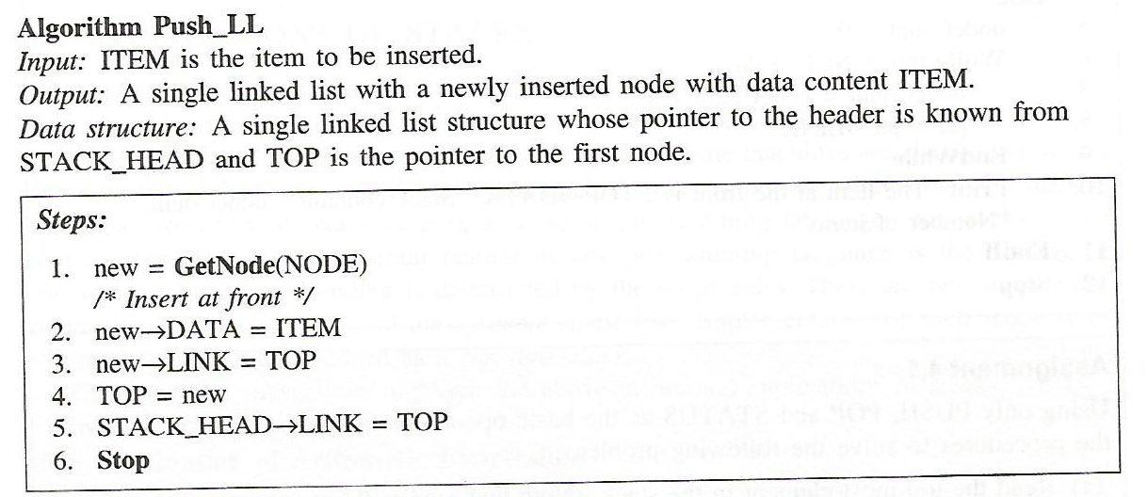

Slide 24
Program to push
void push()
{struct node *ptr;
printf("\n\nEnter ITEM: ");
scanf("%d", &item);
if (top == NULL)
{top = (struct node *)malloc(sizeof(struct node));
top->info = item;
top->link = NULL;}
else
{ptr = top;
top = (struct node *)malloc(sizeof(struct node));
top->info = item;
top->link = ptr;
}
printf("\nItem inserted: %d\n", item); }

Slide 25
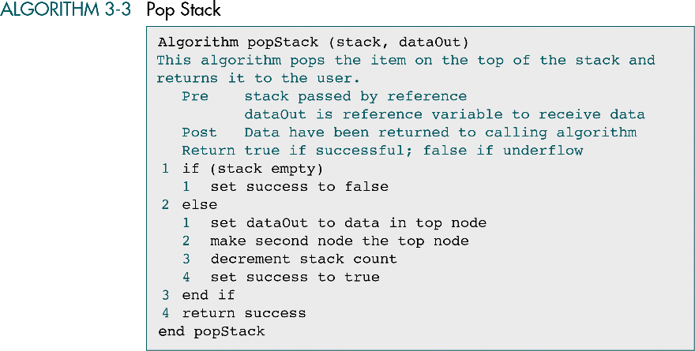

Slide 26
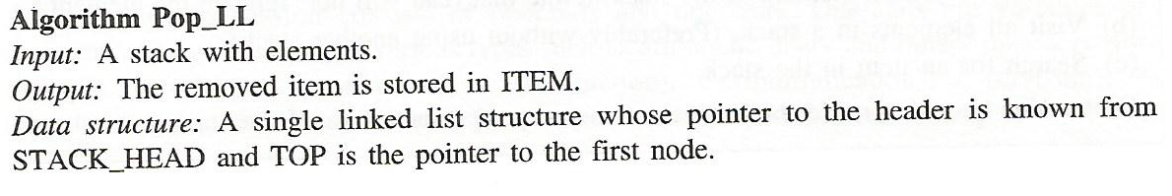
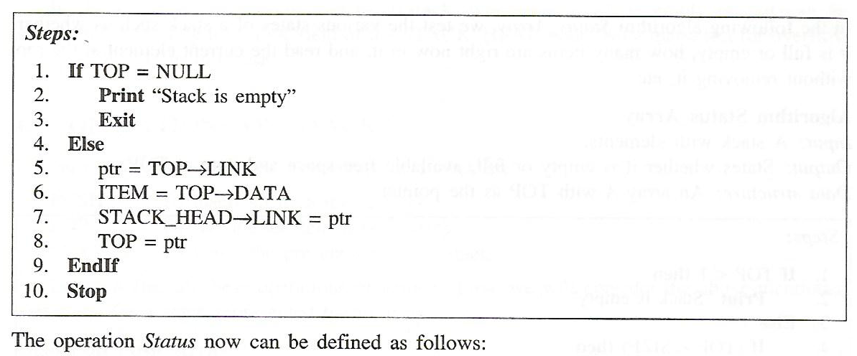

Slide 27
Program to pop
void pop()
{
struct node *ptr;
if (top == NULL)
printf("\n\nStack is empty\n");
else
{
ptr = top;
item = top->info;
top = top->link;
free(ptr);
printf("\n\nItem deleted: %d", item);
}
}

Slide 28
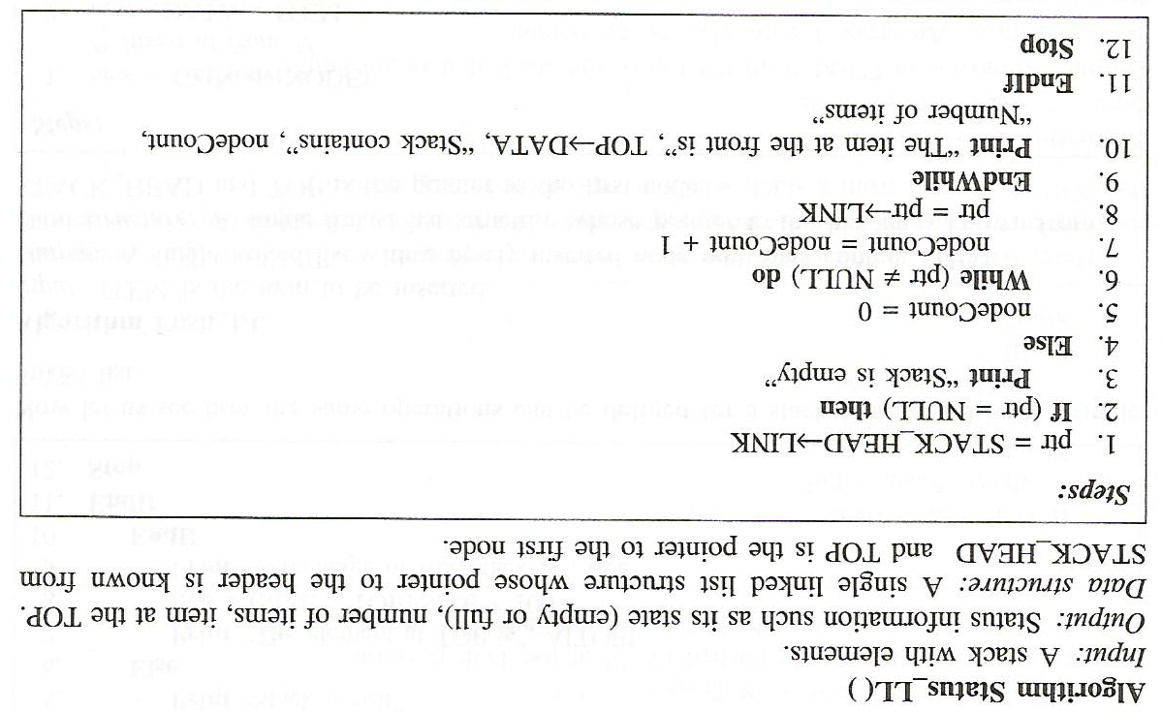

Slide 29
Traversing
void display()
{
struct node *ptr;
if (top == NULL)
printf("\n\nStack is empty\n");
else
{
ptr = top;
while(ptr != NULL)
{
printf("\n\n%d", ptr->info);
ptr = ptr->link;
}

Slide 30
Applications of Stacks
Stack applications can be classified into four broad categories: reversing data, backtracking steps.
Direct applications
Page-visited history in a Web browser
Undo sequence in a text editor
Program execution
Evaluating postfix expressions
Indirect applications
Auxiliary data structure for algorithms
Component of other data structures

Slide 31
/* Below program is written in C++ language */
# include<iostream>
using namespace std;
class Stack
{ int top;
public:
int a[10]; //Maximum size of Stack
Stack()
{ top = -1; }
// declaring all the function
void push(int x);
int pop();
void isEmpty(); };
// function to insert data into stack
void Stack::push(int x)
{

Slide 32
if(top >= 10)
{ cout << "Stack Overflow \n"; }
else
{ a[++top] = x;
cout << "Element Inserted \n"; }
}
// function to remove data from the top of the stack
int Stack::pop()
{ if(top < 0)
{ cout << "Stack Underflow \n";
return 0;
}
else
{
int d = a[top--];
return d;

Slide 33
} }
// function to check if stack is empty
void Stack::isEmpty()
{ if(top < 0)
{ cout << "Stack is empty \n";
}
else
{ cout << "Stack is not empty \n"; }
}
// main function
int main() {
Stack s1;
s1.push(10);
s1.push(100);
/*
preform whatever operation you want on the stack
*/
}

